Slide 1
LESSON 7
BOOK CHAPTER 25
CAPACITANCE

Slide 2
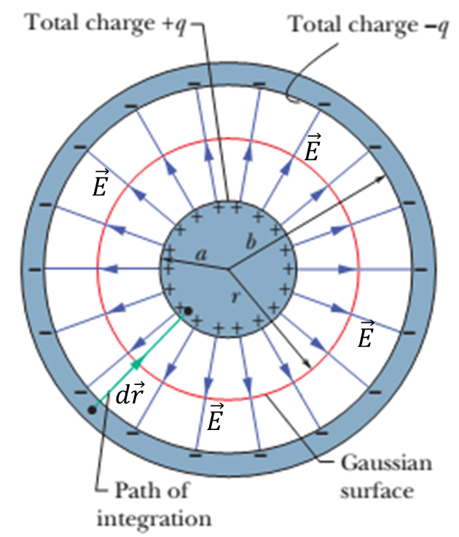
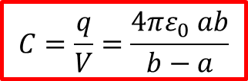

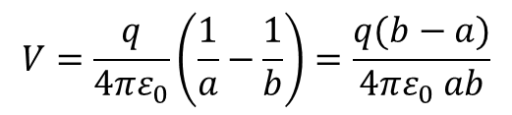

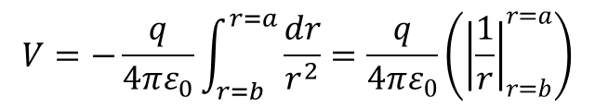

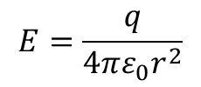
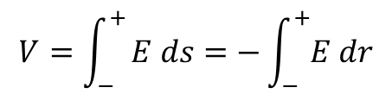
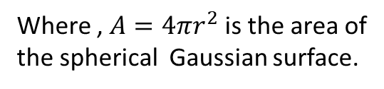
A Spherical Capacitor:
The adjacent figure shows a central cross section
of a spherical capacitor that consists of two concentric spherical shells, of radii a and b..
As a Gaussian surface we draw a sphere of
radius r concentric with the two shells. Then
Applying Gauss’ law
$$ε_{0}EA=q$$
$$ε_{0}E\left(4πr^{2}\right)=q$$
Where , $A=4πr^{2}$ is the area of
the spherical Gaussian surface.
$$E=\frac{q}{4πε_{0}r^{2}}$$
We know
$$V=\int_{−}^{+}{E ds=−\int_{−}^{+}{E dr}}$$
[since $ds=−dr]$
$$V=−\frac{q}{4πε_{0}}\int_{r=b}^{r=a}{\frac{dr}{r^{2}}=\frac{q}{4πε_{0}}\left({\left|\frac{1}{r}\right|}_{r=b}^{r=a}\right) }$$
Figure : A central cross section of a capacitor that consists of two concentric spherical shells, of radii a and b.
$$V=\frac{q}{4πε_{0}}\left(\frac{1}{a}−\frac{1}{b}\right)=\frac{q(b−a)}{4πε_{0} ab}$$
$$C=\frac{q}{V}=\frac{4πε_{0} ab}{b−a}$$

Slide 3
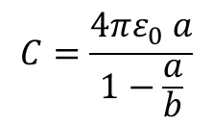


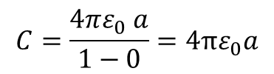

An isolated sphere:
We can assign a capacitance to a single isolated spherical conductor of radius R by assuming that the "missing plate" is a conducting sphere of infinite radius.
$C=\frac{4πε_{0} ab}{b−a}$ as
To find the capacitance of the conductor, we first rewrite
$$C=\frac{4πε_{0} a}{1−\frac{a}{b}}$$
[Dividing both numerator and denominator by b]
If we then let $b→∞$ (infinity), we get
$$C=\frac{4πε_{0} a}{1−0}=4πε_{0}a$$
By substituting R for a, we get
$C=4πε_{0}$R
Which is the capacitance for isolated sphere.

Slide 4
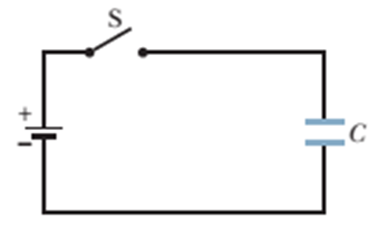
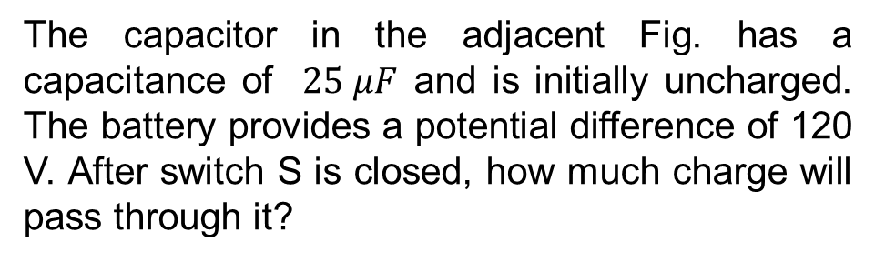





Problem 2 (Book chapter 25):
The capacitor in the adjacent Fig. has a capacitance of $25 μF$ and is initially uncharged. The battery provides a potential difference of 120 V. After switch S is closed, how much charge will pass through it?
Answer:
We know
$$q=CV$$
Given
$$C=25 μF=25×{10}^{−6}F$$
$q=25×{10}^{−6}×120=3×{10}^{−3}$C
$$V=120 V$$
$$q=?$$

Slide 5

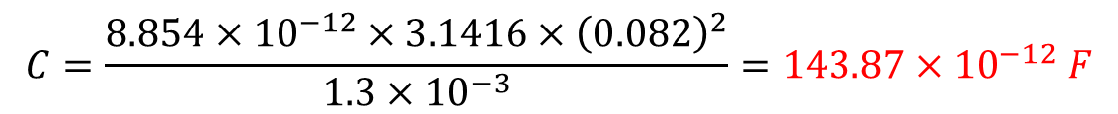
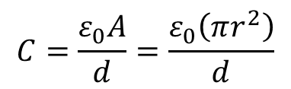


Problem 3 (Book chapter 25):
A parallel-plate capacitor has circular plates of 8.20 cm radius and 1.30 mm separation. (a) Calculate the capacitance. (b) Find the charge for a potential difference of 120 V.
Answer:
(a)
We know
Given
$$r=8.20 cm=0.082 m$$
$$C=\frac{ε_{0}A}{d}=\frac{ε_{0}\left(πr^{2}\right)}{d}$$
$$d=1.30 mm=1.3×{10}^{−3} m$$
$$V=120 V$$
$$C=\frac{{8.854×10}^{−12}×3.1416×{\left(0.082\right)}^{2}}{{1.3×10}^{−3}}=143.87×{10}^{−12} F$$
(b)
We know
$$q=CV=143.87×{10}^{−12}×120=17.26×{10}^{−9} C$$

Slide 6
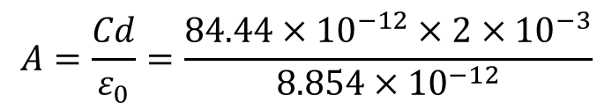

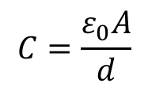

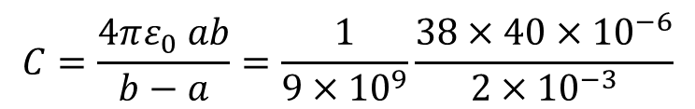





Problem 4 (Book chapter 25):
The plates of a spherical capacitor have radii 38.0 mm and 40.0 mm. (a) Calculate the capacitance. (b) What must be the plate area of a parallel-plate capacitor with the same plate separation and capacitance?
Answer:
(a)
We know
Given
$$C=\frac{4πε_{0} ab}{b−a}=\frac{1}{9×{10}^{9}}\frac{38×40×{10}^{−6}}{2×{10}^{−3}}$$
$$a=38 mm=38×{10}^{−3} m$$
$$b=40 mm=40×{10}^{−3} m$$
$$C=84.44×{10}^{−12} F$$
$$b−a=2 mm=2×{10}^{−3} m$$
(b)
For a parallel plate capacitor, we know
$$C=\frac{ε_{0}A}{d}$$
Here
$$A=\frac{Cd}{ε_{0}}=\frac{84.44×{10}^{−12}×2×{10}^{−3}}{{8.854×10}^{−12}}$$
$$d=b−a=2 mm=2×{10}^{−3} m$$
$$A=19.074×{10}^{−3} m^{2}$$
$$A=?$$

Slide 7

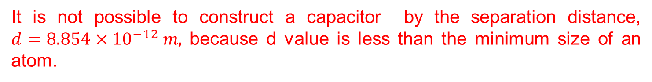

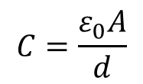
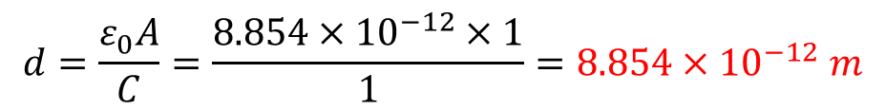

Problem 6 (Book chapter 25):
You have two flat metal plates, each of area 1.00 m², with which to construct a parallel-plate capacitor. (a) If the capacitance of the device is to be 1.00 F, what must be the separation between the plates? (b) Could this capacitor actually be constructed?
Answer:
Given
(a)
We know
$$C=\frac{ε_{0}A}{d}$$
$$A=1.00 m^{2}$$
$$C=1.00 F$$
$$d=\frac{ε_{0}A}{C}=\frac{8.854×{10}^{−12}×1}{1}=8.854×{10}^{−12} m$$
(a)
$$d=?$$
(b) Could this capacitor actually be constructed?
(b)
It is not possible to construct a capacitor by the separation distance, $d=8.854×{10}^{−12} m,$ because d value is less than the minimum size of an atom.

Slide 8
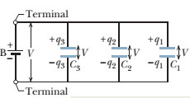
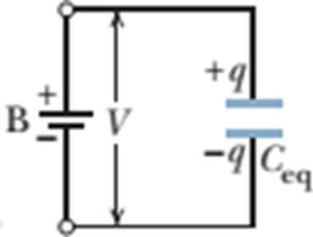



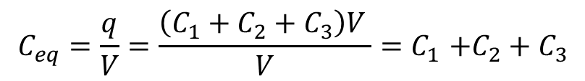


Capacitors in parallel combination:
Charge on each capacitor:
$$q_{1}=C_{1}V$$
$$q_{2}=C_{2}V$$
$$q_{3}=C_{3}V$$
The total charge on the parallel combination is then
$$q=q_{1}+q_{2}+q_{3}=\left(C_{1}+C_{2}+C_{3}\right)V$$
The equivalent capacitance, with the same total charge q and applied potential difference V as the combination, is then
$$C_{eq}=\frac{q}{V}=\frac{\left(C_{1}+C_{2}+C_{3}\right)V }{V}{=C}_{1}+C_{2}+C_{3}$$
$$C_{eq}{=C}_{1}+C_{2}+C_{3}$$

Slide 9
Thank You

